Slide 1
SQL
Lection 3
Queries to table(s)

Slide 2
Introduction to queries

Slide 3




Key components, that handle SQL queries
SQL query
Query parsing component
Query processor
Optimizer
File manager
DBMS mechanisms for working with content
Transaction manager
Database content

Slide 4
Key components, that handle SQL queries
SQL query
The DBMS will processing the request
to find the best way to prepare the data
Query parsing component
Query processor
Optimizer
The DBMS can remember the best data search path and reuse it
File manager
DBMS mechanisms for working with content
Transaction manager
Database content

Slide 5
Key components, that handle SQL queries
SQL query
To compare query performance parameters, as well as to analyze the actions of the DBMS, you can use the query execution plan (explain select...)
Query parsing component
Query processor
Optimizer
File manager
DBMS mechanisms for working with content
Transaction manager
Database content

Slide 6
Main SELECT Query Clauses
All parts of SELECT
1. SELECT​
2. FROM​
3. WHERE​
4. GROUP BY​
5. HAVING ​
6. ORDER BY
7. LIMIT
The most frequently used parts. What to display, where to get it and how to look for it
Used in aggregate calculations
Sorting
Number of lines in output
DBMS vendors may add support for additional keywords. Postgres has such additions.

Slide 7
Queries select from where

Slide 8
About support for relational operations in SQL
You can write queries in SQL that match all the operations available in the relational data model.
The SQL language supports significantly more features compared to those described in the relational data model.

Slide 9
Supported relational operations
Projection
Selection
Rename
Set Union. Join rows vertically
Set Difference
Set Intersection
Joins (differnt way to attach rows horizontally)

Slide 10
Structure of a SELECT query with selection (search condition) and projection
SELECT comma separated expressions
FROM table (sets)
WHERE search condition (selection)
LIMIT N numbers of rows for output

Slide 11



Structure of a SELECT query with selection (search condition) and projection
3
SELECT comma separated expressions
FROM table
WHERE filter
conditions
Expressions are applied to each individual row that will be obtained after filtering
1
2
The search condition is applied to table rows

Slide 12
Examples of queries
select *
from driver d;
select 1
from driver d;
select 'строка'
from driver d;
All columns
All rows in the result set will be filled with the same values

Slide 13
Projection operation in SQL
The projection leaves only the specified attributes
You can also write expressions in SQL that will be used to add calculated columns to a result set
SELECT capacity FROM class
SELECT * means select all columns
clsid | capacity | bags | transmission
A | 2 | 1 | m
B | 2 | 1 | a
C | 5 | 3 | m
D | 5 | 3 | a
capacity
2
2
5
5

Slide 14
Projection operation in SQL
You can select unique records in SQL
Find all unique existing transmission and passenger capacity combinations
SELECT DISTINCT transmission, capacity FROM class
Unique rows
clsid | capacity | bags | transmission
A | 2 | 1 | m
B | 2 | 1 | a
C | 5 | 3 | m
D | 5 | 3 | a
transmission | capacity
m | 2
a | 2
m | 5
a | 5

Slide 15
Projection operation in SQL
You can select unique records in SQL
The query finds all unique capacity values:
SELECT DISTINCT capacity FROM class
clsid | capacity | bags | transmission
A | 2 | 1 | m
B | 2 | 1 | a
C | 5 | 3 | m
D | 5 | 3 | a
capacity
2
5

Slide 16
Selecting all fields from the tables available in the query
The queries below contain expressions with * :
SELECT * FROM X;
SELECT X.* FROM X;
SELECT X.*, X.* FROM X;
SELECT X.* FROM X LIMIT 10;
limit 10 limits the number of rows in the result

Slide 17
What can be written inside from?
Table
View
Derived table
Table function
You can add an alias to objects mentioned inside FROM
If a table has an alias, then in full field names you can only indicate it, and not the original name
An alias (renaming in the context of a single request) can be used for:
ease of writing code
including one table several times in a query
naming derived tables
necessarily with a pseudonym(alias):

Slide 18
What can be written inside from?
In addition to the table, you can use a view
A view in a database is associated with a query that is executed when the view is accessed.
Views may be edited
Views are often used to organize database client access to data.
CREATE VIEW V_CARS_A AS
SELECT car_id, car_mileage, car_year
FROM car
WHERE cls_id = 'A';

Slide 19

What can be written inside from?
A query can contain not only a table in FROM, but also a derived table
The derived table must have a name appended with as or a space after the closing bracket
SELECT *
FROM (
SELECT expressions FROM X
) as tabX
WHERE conditions
Without it will be error

Slide 20
Another way to add a table to FROM that is not stored in the database
It is necessary to include in the request data on car classes with the corresponding names given below:
A mini cars
B small cars
C mid-size cars
D full-size cars
You can use an expression that returns a table:
VALUES ('A', 'mini cars'),
('B', 'small cars'),
('C', 'mid-size cars'),
('D', 'full-size cars')

Slide 21
Another way to add a table to FROM that is not stored in the database
There was no information about column names on the previous slid
You can add a description of the structure like this:
(
VALUES ('A', 'mini cars'),
('B', 'small cars'),
('C', 'mid-size cars'),
('D', 'full-size cars')
) as class_table(cls_id, cls_text)
Alias
Fields

Slide 22
Another way to add a table to FROM that is not stored in the database
Including a VALUES expression in a SELECT query:
select cls_id, cls_text
from
(
VALUES ('A', 'mini cars'),
('B', 'small cars'),
('C', 'mid-size cars'),
('D', 'full-size cars')
) as class_table(cls_id, cls_text)

Slide 23
Question
Where else can you use renaming?
Are aliases visible outside of the query?

Slide 24
Selection operation in SQL
clsid | capacity | bags | transmission
A | 2 | 1 | m
B | 2 | 1 | a
C | 5 | 3 | m
D | 5 | 3 | a
Returns rows that match a given condition
WHERE
SELECT *
FROM class
WHERE transmission = 'a';
clsid | capacity | bags | transmission
B | 2 | 1 | a
D | 5 | 3 | a

Slide 25
Selection operation in SQL
How to find all Nissan and Peugeot cars produced no earlier than 2018?
cid | make | year | mileage | clsid
1 | nissan | 2017 | 85000 | B
2 | peugeot | 2017 | 79000 | A
3 | peugeot | 2017 | 56000 | B
4 | renault | 2018 | 28000 | D
5 | renault | 2019 | 5500 | A
6 | peugeot | 2019 | 2000 | D
7 | nissan | 2019 | 1500 | C

Slide 26
Selection operation in SQL
How to find all Nissan and Peugeot cars produced no earlier than 2018?
cid | make | year | mileage | clsid
1 | nissan | 2017 | 85000 | B
2 | peugeot | 2017 | 79000 | A
3 | peugeot | 2017 | 56000 | B
4 | renault | 2018 | 28000 | D
5 | renault | 2019 | 5500 | A
6 | peugeot | 2019 | 2000 | D
7 | nissan | 2019 | 1500 | C

Slide 27
Selection operation in SQL
How to find all Nissan and Peugeot cars produced no earlier than 2018?
Condition could be written this way:
year >= 2018 and (make='nissan' or make='peugeot')
cid | make | year | mileage | clsid
1 | nissan | 2017 | 85000 | B
2 | peugeot | 2017 | 79000 | A
3 | peugeot | 2017 | 56000 | B
4 | renault | 2018 | 28000 | D
5 | renault | 2019 | 5500 | A
6 | peugeot | 2019 | 2000 | D
7 | nissan | 2019 | 1500 | C

Slide 28
Selection operation in SQL
How to find all Nissan and Peugeot cars produced no earlier than 2018?
Condition could be written this way:
year >= 2018 and (make = 'nissan' or make = 'peugeot')
Or year >= 2018 and make in('nissan', 'peugeot')
cid | make | year | mileage | clsid
1 | nissan | 2017 | 85000 | B
2 | peugeot | 2017 | 79000 | A
3 | peugeot | 2017 | 56000 | B
4 | renault | 2018 | 28000 | D
5 | renault | 2019 | 5500 | A
6 | peugeot | 2019 | 2000 | D
7 | nissan | 2019 | 1500 | C
select *
from car
where
year >= 2018
and make in('nissan', 'peugeot')
Why this won't work?
year >= 2018 and (make='nissan' and make='peugeot')?

Slide 29
Selection with a condition that always returns false
SELECT make FROM car WHERE 1 = 0;
Condition 1 = 0 – always false
cid | make | year | mileage | clsid
1 | nissan | 2017 | 85000 | B
2 | peugeot | 2017 | 79000 | A
3 | peugeot | 2017 | 56000 | B
4 | renault | 2018 | 28000 | D
5 | renault | 2019 | 5500 | A
6 | peugeot | 2019 | 2000 | D
7 | nissan | 2019 | 1500 | C

Slide 30
Selection with a condition that always returns false
SELECT make FROM car WHERE 1 = 0;
Condition 1 = 0 – always false
cid | make | year | mileage | clsid
1 | nissan | 2017 | 85000 | B
2 | peugeot | 2017 | 79000 | A
3 | peugeot | 2017 | 56000 | B
4 | renault | 2018 | 28000 | D
5 | renault | 2019 | 5500 | A
6 | peugeot | 2019 | 2000 | D
7 | nissan | 2019 | 1500 | C
make
Empty table with one
Column make

Slide 31
Query with condition IN
… WHERE expression IN (…)
Can be used with NOT (not in ( ... ) )
We need to find cars belonging to classes A and B:
select *
from car
where clsid in ('A', 'C')

Slide 32
Query with condition IN
… WHERE expression IN (…)
Can be used with NOT (not in ( ... ) )
We need to find cars belonging to classes A and B:
select *
from car
where clsid in (select clsid from class where
transmission='a')

Slide 33
Query with BETWEEN condition
… WHERE … expression BETWEEN a AND b
We need to find all cars with mileage from 20k to 100k
select *
from car
where mileage between 20000 and 100000
BETWEEN can be replaced:
… where mileage >= 20000 and mileage <= 100000

Slide 34
Query with search by pattern
... WHERE ... LIKE expression pattern
Special characters in the pattern (mask):
_ - any one symbol
% - any number of any characters
We need to find all drivers whose name begins with D
select *
from driver
where name like 'D%'
In PG, the case-insensitive version of this operator is called ILIKE
If you need to include _ and % in the pattern, you must add the ESCAPE Escape Character keyword after the pattern

Slide 35
Using Aliases in SQL
In the context of one query, you can change the name of a table or table expression to a given name
Renaming is necessary to:
use the same relation multiple times in the same query
replace the long name with a short one in the request
give the derived table a name (required)
Example:
SELECT c.cid FROM car c
SELECT c.* FROM car as c where c.mileage > 100
AS could be skipped
SELECT car.* FROM car as c where c.mileage > 0
One of this queries won't work

Slide 36
Using Aliases in SQL
A query with a nested query table will not work unless you add a name to the nested query:
SELECT * FROM (
SELECT cid
FROM car
WHERE year >= 2018 and (make = 'nissan' or make = 'peugeot')
) as data

Slide 37
Using Aliases in SQL
SQL supports aliases for:
expressions in SELECT
tables, views, queries and CTEs inside FROM
Adding an alias
Using AS
It is allowed to use renaming without AS
There are cases where the AS keyword is required (see documentation)

Slide 38
About using CTE (Common table expression) in a query
A derived table can be in FROM
You can add many derived tables in one query
postgreSQL supports CTE - common table expressions. Generalized table expressions
In a simple case, it looks like a derived table written above SELECT after WITH
CTE can be not only in SELECT, but also INSERT, UPDATE and DELETE
Modifying CTEs are executed in any case, even if the main query returns nothing

Slide 39
About using CTE in a query
CTE syntax
WITH name_of_cte AS (
SELECT *
FROM sales_people
WHERE
city_name = 'London'
)
SELECT *
FROM name_of_cte
It is allowed to add several CTEs to a request at once, as well as use links to other CTEs from a CTE

Slide 40
About using CTE in a query
WITH name_of_cte AS (
SELECT *
FROM sales_people
WHERE
city_name = 'London'
) ,
one_more_cte AS (
SELECT ...
)
SELECT *
FROM name_of_cte .... one_more_cte ....
In this query there are two CTEs

Slide 41
Queries without FROM
Postgres allows you to write queries without FROM
SELECT a, b as col2, 123;
SELECT now() as cur_time;
In some other DBMSs, you need to specify a special system table in FROM. For example, dual in Oracle or dummy in SAP HANA

Slide 42
Sorting. Controlling the order in which rows are displayed
One of the last clauses in the SELECT query
SELECT
FROM
WHERE
ORDER BY expression1 asc or desc, expression1 asc or desc …
Sorting can be done on multiple columns
Descending – DESC, ascending – ASC (default)
You don't have to specify the order. This will mean ASC

Slide 43
Sorting. Controlling the order in which rows are displayed
The result depends on the data type
select a from tab order by a asc
a
1
14
10
2
a
1
2
10
14
a
1
10
14
2
a
01
02
10
14
Data
Sort as number
Sort as text
Leading zeros affect the sort order of text

Slide 44
Sorting. Controlling the order in which rows are displayed
What can you write in ORDER BY?
Expressions
Aliases from SELECT
Expression numbers from SELECT starting from 1
select
did,
bid,
start,
finish
from res
order by
1, start desc

Slide 45
Sorting. Controlling the order in which rows are displayed
You can use ORDER BY together with LIMIT to get the first or last N rows based on a specific criterion
The example below will return the single longest booking:
select
days
from res
order by days desc
limit 1

Slide 46
An interesting example of using distinct together with sorting
Postgres has a distinct on (...) clause that returns rows for which the combination of expressions in on (...) is unique.
If there are multiple rows for the same combination, the row that is higher in the sort order specified in ORDER BY will be retained.

Slide 47
An interesting example of using distinct together with sorting
Postgres has a distinct on (...) clause that returns rows for which the combination of expressions in on (...) is unique.
If there are multiple rows for the same combination, the row that is higher in the sort order specified in ORDER BY will be retained.
SELECT DISTINCT ON (ex1, ex2,.. exn)
expressions
FROM
...
ORDER BY ex1, ex2,.. exn, ....;

Slide 48
An interesting example of using distinct together with sorting
If there are multiple versions of the same row in a table, then distinct on can be used to highlight the latest records
SELECT DISTINCT ON (res_id)
res_id,
amount,
start_date
FROM
reservations
ORDER BY res_id, version_time desc;

Slide 49
Series generator
generate_series

Slide 50
Table functions generating series values
Postgres supports functions that return multiple values from a sequence
generate_series(start, end)
generate_series(start, end, step)
generate_series(start, end, step interval)

Slide 51
Table functions generating series values
Postgres supports functions that return multiple values from a sequence
generate_series(start, end)
generate_series(start, end, step)
generate_series(start, end, step interval)
Number
Date(time)
'10 days'::interval

Slide 52
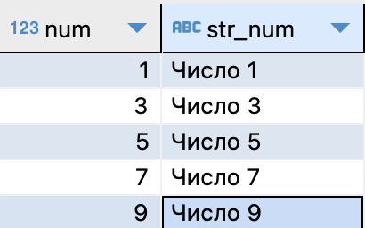
Table functions generating series values
Postgres supports functions that return multiple values from a sequence
select
num,
'Число ' || num as str_num
from
generate_series(1, 10, 2) as tab_1_10(num);
This uses a function to get sequential numbers from 1 to 10 in increments of 2

Slide 53
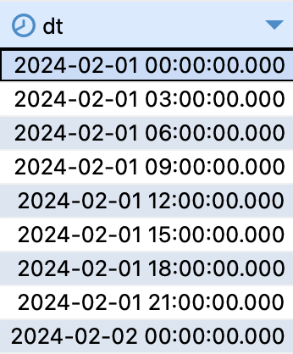
Table functions generating series values
Postgres supports functions that return multiple values from a sequence
select
dt
from
generate_series(
'2024-02-01'::timestamp,
'2024-02-02',
'3 hours'::interval) as dates(dt);
This function can also generate a sequence of dates and timestamps

Slide 54
Operations on sets
UNION
EXCEPT
INTERSECT

Slide 55
Supported relational operations
Projection
Selection
Rename
Set Union. Join rows vertically
Set Difference
Set Intersection
Joins (differnt way to attach rows horizontally)

Slide 56
Operations on sets
UNION
INTERSECT
EXCEPT (Set Difference)
Participating tables must have the following properties:
Same number of attributes
Matching data type in matching attributes

Slide 57
Operations on sets
UNION
INTERSECT
EXCEPT (Set Difference)
In SQL, these operations will return unique rows. You can disable this feature by using the word ALL. For example, UNION ALL

Slide 58
Operations on sets
UNION
INTERSECT
EXCEPT (Set Difference
In SQL, these operations will return unique rows. You can disable this feature by using the word ALL. For example, UNION ALL

Slide 59
Operations on sets
Union X and Y
Unique (or all) rows of their two tables
Except X and Y
Rows found in X but not in Y
Intesect X and Y
Shared rows contained in two tables at the same time
SELECT ...
FROM ...
WHERE ...
Operation
SELECT ...
FROM ...
WHERE ...
Operation
SELECT ...
FROM ...
WHERE ...
.....

Slide 60
UNION in SQL. Example 1
Example №1. Merging multiple tables
You need to get a table containing geographical names - countries and cities. Each line must correspond to a city or country
Required result format:
geo_name – name
geo_type_name – type of name. Country or city
population – popultaion :)

Slide 61
UNION in SQL. Example 1
Example №1. Merging multiple tables
You need to get a table containing geographical names - countries and cities. Each line must correspond to a city or country
select
name as geo_name, 'country' as geo_type_name, population
from country
select
name as geo_name, 'city' as geo_type_name, population
from city
Only country
Only city

Slide 62
UNION in SQL. Example 1
Example №1. Merging multiple tables
You need to get a table containing geographical names - countries and cities. Each line must correspond to a city or country
The query result will look like this:
Only country
select
name as geo_name,
'country' as geo_type_name,
population
from country
union all
select
name as geo_name,
'city' as geo_type_name,
population
from city
UNION ALL
Only city

Slide 63
UNION in SQL. Example 1
Example №1. Merging multiple tables
Now let's try to add continents to the request
select
name as geo_name,
'country' as geo_type_name,
population
from country
union all
select
name as geo_name,
'city' as geo_type_name,
population
from city
union all
select
continent as geo_name,
'continent' as geo_type_name,
null
from country;
Only country
UNION ALL
Only city
UNION ALL
We do not indicate the population here
Only continents

Slide 64
UNION in SQL. Example 1
Example №1. Merging multiple tables
Sorting and limiting the number of rows
No brackets at the end. You need to use the column number or column name in the query result
In brackets in any part of the query
select
name as geo_name,
'county' as geo_type_name,
population
from country
union all
select
name as geo_name,
'city' as geo_type_name,
population
from city
order by geo_name
limit 50;
Will apply to the entire query
If you write name instead of geo_name, there will be an error

Slide 65
UNION in SQL. Example 1
Example №1. Merging multiple tables
Sorting and limiting the number of rows
No brackets at the end. You need to use the column number or column name in the query result
In brackets in any part of the query
(select
name as geo_name,
'county' as geo_type_name,
population
from country
order by geo_name
limit 50)
union all
select
name as geo_name,
'city' as geo_type_name,
population
from city
;
Will only apply to the first query
If you remove the parentheses, there will be an error
It was possible to write name instead of geo_name

Slide 66
UNION in SQL. Example 1
Example №1. Merging multiple tables
Error in postgresql
select
name as geo_name,
'country' as geo_type_name,
population
from country
order by 1
limit 50
union all
select
name as geo_name,
'city' as geo_type_name,
population
from city
;
No brackets

Slide 67
UNION in SQL. Example 1
Example №1. Merging multiple tables
Column names
Column names are determined by the first request
In the second and subsequent queries, connected operations on sets, you can omit the column names
An important limitation is that the data types of values in one column must match
(select
name as geo_name,
'country' as geo_type_name,
population
from country
order by 1
limit 50)
union all
select
name as geo_name,
'city' as geo_type_name,
population
from city
;

Slide 68

UNION in SQL. Example 2
Example 2. Displaying values from different columns in one column
We need to find all the dates when the drivers started or ended the booking
The source data contains booking records
Start date
Completion date
Unique dates:

Slide 69
UNION in SQL. Example 2
Example 2. Displaying values from different columns in one column
We need to find all the dates when the drivers started or ended the booking
To do this, you can read values from one field, then from another field and combine the results using UNION

Slide 70
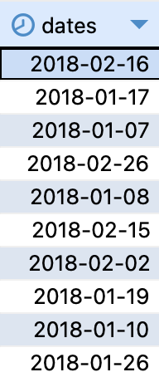
UNION in SQL. Example 2
Example 2. Displaying values from different columns in one column
We need to find all the dates when the drivers started or ended the booking
select start
from res
union
select finish
from res
select start as dates
from res
union
select finish
from res;

Slide 71
Connection of UNION and WHERE
A query on a single table with an OR condition can also be implemented using UNION
SELECT *
from car
WHERE
clsid='A'
union all
SELECT *
from car
WHERE
clsid='B';
SELECT *
from car
WHERE
clsid='A' or clsid='B';

Slide 72
EXCEPT – set difference
EXCEPT returns records from the first table that are missing from the second
Possible use case: checking whether two query results match

Slide 73
EXCEPT – set difference
You need to compare two tables with the same structure and find the differences
create table if not exists car_b as
select *
from car
where clsid = 'B';
select *
from car
tables/queries
EXCEPT
=
Empty table
EXCEPT
=
Rows group

Slide 74
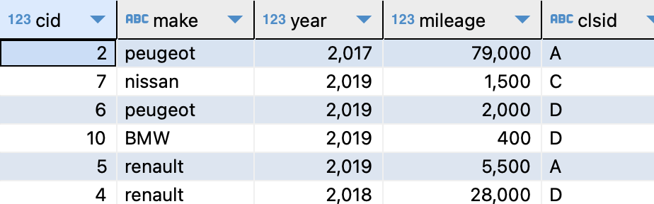
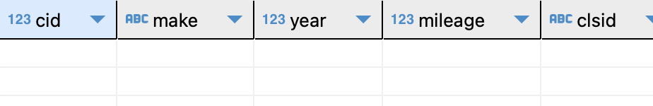
EXCEPT – set difference
You need to compare two tables with the same structure and find the differences
select *
from car
except
select *
from car_b;
select *
from car_b
except
select *
from car;

Slide 75
EXCEPT – set difference
You need to compare two tables with the same structure and find the differences
select *
from car
except
select *
from car_b;
select *
from car_b
except
select *
from car;
If both queries return an empty table, then their results are the same

Slide 76
Connection of EXCEPT and WHERE
A query against a single table with an AND condition can also be implemented using EXCEPT with the addition of the opposite condition
We need to find all bookings made at the airport lasting more than 12 days
select *
from res
where
pickat = 'airport'
and days <= 12;
(select *
from res
where pickat = 'airport')
except
(select *
from res
where days > 12)
Opposite
condition

Slide 77
INTERSECT – intersection of sets
INTERSECT returns common rows simultaneously contained in the results of both queries
tables/queries
INTERSECT
=
INTERSECT
=
Empty table

Slide 78
INTERSECT – intersection of sets
INTERSECT returns common rows simultaneously contained in the results of both queries
The query below will find all the cars in the car_b table that are also the result of a query on the car table that returns cars with more than 60,000 miles on them
select *
from car_b
intersect
select *
from car
where mileage > 60000

Slide 79
Connection of INTERSECT and WHERE
If INTERSECT uses the same table, then it can be implemented using a condition with AND
We need to find all cars in class A with mileage up to 20,000
Here you can rewrite the query using a condition with AND
select *
from car
where clsid = 'A'
intersect
select *
from car
where mileage < 20000;
select *
from car
where
clsid = 'A'
and mileage < 20000;

Slide 80
Join operations
CROSS JOIN
JOIN

Slide 81
Join
Problem:
How to find all the cars that were rented at the airport?
The information is in different tables – car and res
You must first compare the rows of different tables so that the car data and the corresponding booking record appear in the same row when executing the query.
Solution:
Use the JOIN operation

Slide 82
Join
Problem:
You need to display all reservations for one car for a certain period, indicating the names of the drivers
The information is in different tables – res and driver
For each line from res, you need to find a record about the driver whose key is indicated in this line
Solution:
Use the JOIN operation

Slide 83
Join
The join operation adds records horizontally, unlike set operations
Elimination of duplicates after join is not provided unless the distinct keyword is specified in select
Place of JOIN - inside the FROM clause
tables/queries
JOIN
=
Left table
Right table

Slide 84
Join
SQL supports several variants of the join operator
Cartesian product
Inner join
External join
And there is also a semi-join and an anti-join. Implemented in WHERE

Slide 85
Cartesian product. CROSS JOIN
Returns all possible combinations of rows from the left and right table
SELECT * FROM Tab1, Tab2
SELECT * FROM Tab1 CROSS JOIN Tab2
Tab1 X Tab2
Tab1
Tab2
b1 | b2 | b3 | a1 | a2
C1 | C2 | C3 | A1 | A2
D1 | D2 | D3 | A1 | A2
C1 | C2 | C3 | B1 | B2
D1 | D2 | D3 | B1 | B2
b1 | b2 | b3
C1 | C2 | C3
D1 | D2 | D3
a1 | a2
A1 | A2
B1 | B2
X
=

Slide 86
INNER JOIN
You need to display a list of all cars along with data from the class table. In this example - transmission
The first query option (incorrect) is to simply add both tables to FROM
SELECT
cid,
mileage,
transmission
FROM
car, class;

Slide 87

INNER JOIN
You need to display a list of all cars along with data from the class table. In this example - transmission
This query will use the cross join operation
SELECT
cid,
mileage,
transmission
FROM
car, class;
car
All combinations of rows from car and class
class

Slide 88
INNER JOIN
You need to display a list of all cars along with data from the class table. In this example - transmission
This query will use the cross join operation
SELECT
cid,
mileage,
transmission
FROM
car, class;
The full set of row combinations from two tables contains more data than necessary.
Useful rows are only those in which the machine class key matches the key in the class table
cid | mileage | transmission
1 | 85000 | m
1 | 85000 | a
1 | 85000 | a
… | … | …
7 | 1500 | m
7 | 1500 | a

Slide 89
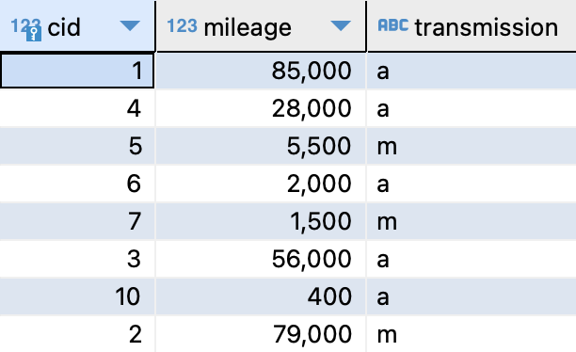

INNER JOIN
You need to display a list of all cars along with transmission data
The condition car.clsid = class.clsid will select logically related rows (cars and classes to which each of them belongs)
SELECT
cid,
mileage,
transmission
FROM
car, class
WHERE
car.clsid = class.clsid;
SELECT
cid,
mileage,
transmission
FROM
car as c, class as cl
WHERE
c.clsid = cl.clsid;
One car – one row
Verison with aliases

Slide 90
INNER JOIN
You need to display a list of all cars along with transmission data
Instead of WHERE condition, you can use JOIN
JOIN is the preferred join method because it provides more functionality
SELECT
cid,
mileage,
transmission
FROM
car as c
inner join class as cl
on c.clsid = cl.clsid;
The DBMS uses its own string matching algorithms:
hash join
nested loop
merge join
Notes:
Equijoin – all conditions are equalities

Slide 91
INNER JOIN
If two queries look different, this does not mean that the DBMS will use different data processing methods for these queries
These queries will be executed the same way:
SELECT cid, mileage, transmission FROM car c JOIN class cl ON c.clsid = cl.clsid
SELECT cid, mileage, transmission FROM car c, class cl WHERE c.clsid = cl.clsid

Slide 92
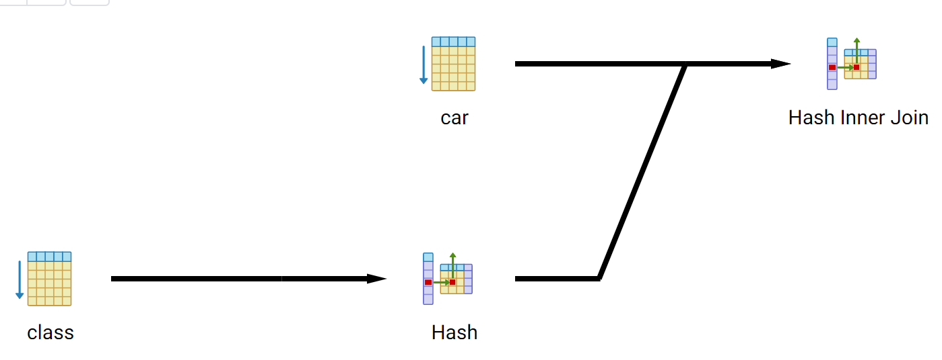
INNER JOIN
Execution plans for two queries coincide
SELECT sid, mileage, transmission FROM car c JOIN class cl ON c.clsid = cl.clsid
SELECT sid, mileage, transmission FROM car c, class cl WHERE c.clsid = cl.clsid
Notes:
Equijoin – all conditions are equalities

Slide 93
General syntax for joins
SELECT expression
FROM Table1 join Table2 on condition
join Table3 on condition
WHERE
...
FROM can contain multiple JOIN operations

Slide 94
General syntax for joins
The theory describes a subtype of connection - natural join. This is an inner join whose condition uses columns of two tables with the same names
PostgreSQL has a special using construct (columns separated by commas) in on
SELECT
cid,
mileage,
transmission
FROM car c
JOIN class cl using (clsid);
The query will work because car and class have a column named clsid
This condition can be rewritten as follows:
c.clsid = cl.clsid

Slide 95
Using the same table multiple times in a query
You can use the same table more than once in a join operation
Below are two tables - users and their messages. You need to display messages with the names of receivers and senders
uid | name
1 | Carol
2 | Sophie
mid | text | sender | receiver
1 | Hi! | 1 | 2
2 | Lets write a query | 1 | 2
3 | I don't know how | 2 | 1
4 | Can you help me? | 2 | 1
5 | Yeah, with pleasure | 1 | 2

Slide 96
Using the same table multiple times in a query
uid | name
1 | Carol
2 | Sophie
mid | text | sender | receiver
1 | Hi! | 1 | 2
2 | Lets write a query | 1 | 2
3 | I don't know how | 2 | 1
4 | Can you help me? | 2 | 1
5 | Yeah, with pleasure | 1 | 2
SELECT
s.name as sender,
r.name as receiver,
message.text
FROM message m
JOIN user as s on m.sender = s.uid
join user as r on message.receiver = r.uid;

Slide 97
Using the same table multiple times in a query
user as s
message as m
uid | name
1 | Carol
2 | Sophie
mid | text | sender | receiver
1 | Hi! | 1 | 2
2 | Lets write a query | 1 | 2
3 | I don't know how | 2 | 1
4 | Can you help me? | 2 | 1
5 | Yeah, with pleasure | 1 | 2
user as r
uid | name
1 | Carol
2 | Sophie
SELECT
s.name as sender,
r.name as receiver,
message.text
FROM message m
JOIN user as s on m.sender = s.uid
join user as r on message.receiver = r.uid;
text | sender | receiver
Hi! | Carol | Sophie
Lets write a query | Carol | Sophie

Slide 98
Example of a complex request
Problem: Who ordered the same cars as Linda?

Slide 99
Example of a complex request
Problem: Who ordered the same cars as Linda?
The query must answer the following questions:
What kind of bookings did Linda make?
What cars were mentioned in these bookings?
What reservations are associated with these vehicles?
Which drivers were included in these bookings other than Linda?

Slide 100
Conditional expression in SQL
CASE ... END

Slide 101
Conditional expression
Imperative programming style
Declarative programming style
if condition
then execute code if condition returns true
else code executed in other cases
endif
if condition
then value if the condition is true
else different value in other cases
endif

Slide 102
Two options for writing a conditional expression in SQL
Selecting an option for the value of the expression
Selecting the first condition from a list of conditions that returns true
CASE expr
WHEN val1 THEN result1
WHEN val2 THEN result2
…
ELSE result in other cases
END
CASE
WHEN ex1 = v1 THEN result1
WHEN ex2 > v2 THEN result2
WHEN ex3 is null and ... THEN result3
…
ELSE result in other cases
END

Slide 103
Selecting an option for the value of the expression
Row with clsid = 'B'
This expression calculates the value for one field
case and end define the beginning and end of a single conditional expression
case clsid
when 'A' then 'Compact cars'
when 'B' then 'Compact cars'
when 'C' then 'Medium cars'
when 'D' then 'Medium cars'
else 'Big cars'
end as car_size
A
B
C
D
The previous conditions are not met
The value in the car_size field will be equal to Medium cars

Slide 104
Selecting an option for the value of the expression
SELECT
cid,
mileage,
case clsid
when 'A' then 'Compact cars'
when 'B' then 'Compact cars'
when 'C' then 'Medium cars'
when 'D' then 'Medium cars'
else 'Big cars'
end as car_size
FROM car
Conditional expression as part of a query
car_size is the name of the corresponding field

Slide 105
Selecting the first condition from a list of conditions that returns true
Example query with conditional expression:
SELECT
cid,
case
when mileage <= 50 then 'New'
when mileage <= 20000 then 'As New'
else 'Used'
end as car_state
FROM car
The expression will return the value from the first branch encountered in which the expression after WHEN is true
If no condition matches and there is an ELSE block, then the value from this block will be returned.
Otherwise the result is NULL

Slide 106
The data types in the conditional expression must match
All expressions must be of the same type
Type mismatches lead to errors
select
case
when c.population >= 100000
then c.population
else 'Менее 100 тысяч'
end p_100k
from country c
number
text

Slide 107
The data types in the conditional expression must match
The results in all branches of the conditional expression must have the same data type
Sometimes you need to use type conversion
select
case
when c.population >= 100000 then c.population::varchar
else 'less than 100k'
end p_100k
from country c
select
case
when c.population >= 100000 then c.population || ''
else 'less than 100k'
end p_100k
from country c
Number in varchar
Varchar as well

Slide 108
Thanks for attention

